Slide 1

$ pentest_report.exe
Nahamstore Web Application Penetration Test
Executive Briefing & Remediation Plan
Target
Report Date
nahamstore.thm
12 November 2025
Engagement Date
Assessment Type
10 October 2025
Black-Box External

Slide 2

Executive Summary: Key Findings Overview
Total Findings
19
1
4
Critical
High
CRITICAL: 1 (RCE)
4
10
HIGH: 4 (SQLi, XXE, LFI, SSRF)
Medium
Low
MEDIUM: 4 (IDOR, 2 CSRF, Stored XSS)
LOW: 10 (6 XSS, 4 Redirects)
Business Impact: Identified vulnerabilities present significant risks to confidentiality, integrity, and availability of the application and underlying systems.

Slide 3
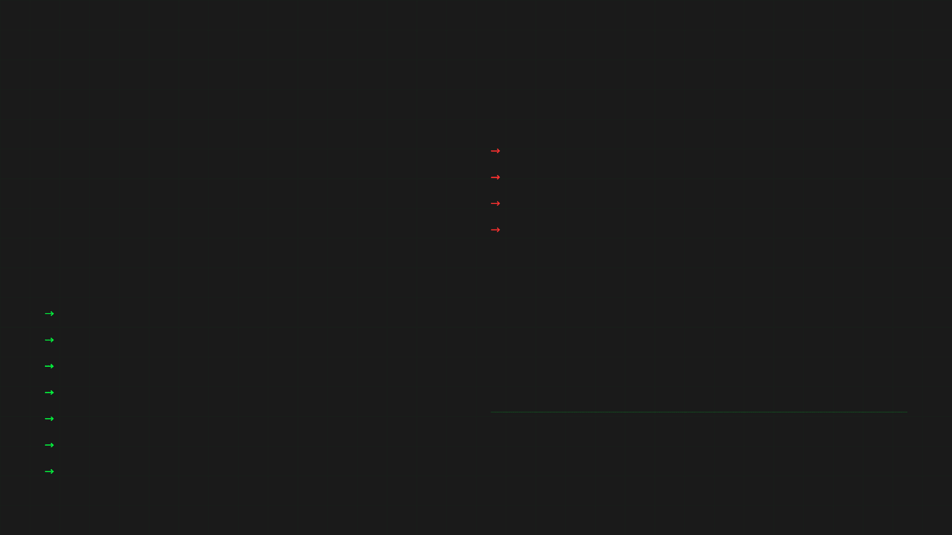
Assessment Scope and Approach
TARGETS (IN-SCOPE)
OUT-OF-SCOPE ACTIVITIES
*.nahamstore.thm
Denial-of-Service (DoS) testing
Social engineering or phishing campaigns
TEST TYPE / APPROACH
Internal network / lateral movement beyond publicly accessible services
Black-box assessment (external, unauthenticated) testing from the public internet without access to source code or privileged credentials.
Any testing requiring privileged credentials or administrative access not provided during the engagement
IN-SCOPE ACTIVITIES
Discovery and reconnaissance (DNS/subdomain enumeration, crawling)
Public-facing application testing (web pages, APIs, parameters)
Authentication/authorization testing from public-user perspective
Client-side and server-side input validation (XSS, SQLi, XXE, LFI, RCE)
Business-logic testing and access control checks (IDOR)
Redirect and CSRF/SSRF assessment
Assessment Focus
Collection of evidence (requests/responses, screenshots)
Comprehensive evaluation of the web application's security posture from an external attacker's perspective, focusing on input validation, authentication, authorization, and business logic vulnerabilities.

Slide 4

Testing Methodology and Security Tools
Testing Methodology
Testing followed industry best practices and OWASP Testing Guide v4. The approach included comprehensive assessment across all major testing phases with focus on real-world attack scenarios.
Reconnaissance
Authentication
Session Mgmt
Input Validation
Business Logic
API Testing
Post-Exploitation
Reporting
Representative Tools Used
Burp Suite Professional
Sqlmap
Nmap
Interception proxy for request/response analysis, parameter fuzzing, and vulnerability scanning.
Automated SQL injection detection and exploitation tool for database enumeration.
Network reconnaissance and port scanning for service discovery and enumeration.
Nikto
Ffuf / Gobuster / Dirsearch
Curl / Httpx
Web server scanner for identifying known vulnerabilities and misconfigurations.
Directory and parameter fuzzing tools for discovering hidden endpoints and resources.
Command-line HTTP clients for manual request crafting and testing.
Arjun
Browser DevTools
Custom Scripts
Parameter discovery tool for identifying hidden query parameters and form fields.
Client-side analysis, JavaScript debugging, and DOM inspection.
Python/Bash scripts for targeted exploitation and proof-of-concept development.

Slide 5

Business Impact: Potential Consequences of Exploitation
Risk Assessment
The identified vulnerabilities present significant risks to the confidentiality, integrity, and availability of the application and its underlying systems. Successful exploitation could result in:
Full Server Compromise
Data Exfiltration & Loss
Complete control of application host through RCE, SQLi, or LFI vulnerabilities. Attackers gain arbitrary command execution, access to all application files, databases, and internal resources.
Exposure of sensitive data including user information, credentials, PII, internal configuration files, and business secrets. Potential modification or deletion of critical data.
CVSS: 9.8 - 9.1 | Affected: RCE, SQLi, LFI
CVSS: 9.1 - 8.0 | Affected: SQLi, XXE, LFI
Unauthorized User Actions
Client-Side Attacks
Attackers force password changes, redirect account communications, and escalate privileges via CSRF and IDOR vulnerabilities. Account takeover and loss of legitimate user access.
Session hijacking, forced actions on behalf of users, and targeted phishing through multiple XSS vectors. Potential compromise of admin accounts if they view malicious content.
CVSS: 6.5 - 6.1 | Affected: CSRF, IDOR
CVSS: 6.1 - 4.3 | Affected: Stored XSS, Reflected XSS
Phishing & Social Engineering
Lateral Movement & Persistence
Abuse of open redirects to enhance phishing campaigns, redirect users to malicious domains, and harvest credentials. Undermines user trust in the application.
Potential for attackers to establish persistent backdoors, move laterally within internal networks, and maintain long-term access for ongoing data theft and system manipulation.
CVSS: 3.4 | Affected: Open Redirects
CVSS: 9.8 | Affected: RCE

Slide 6

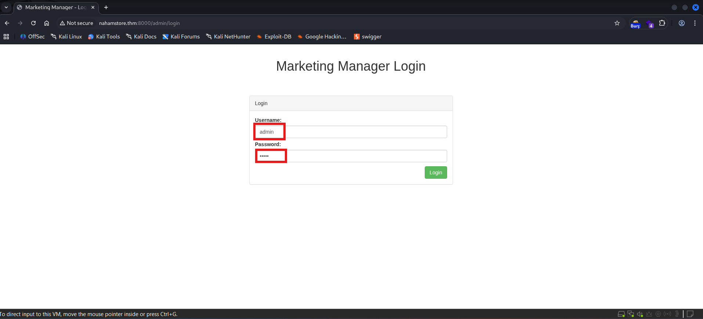
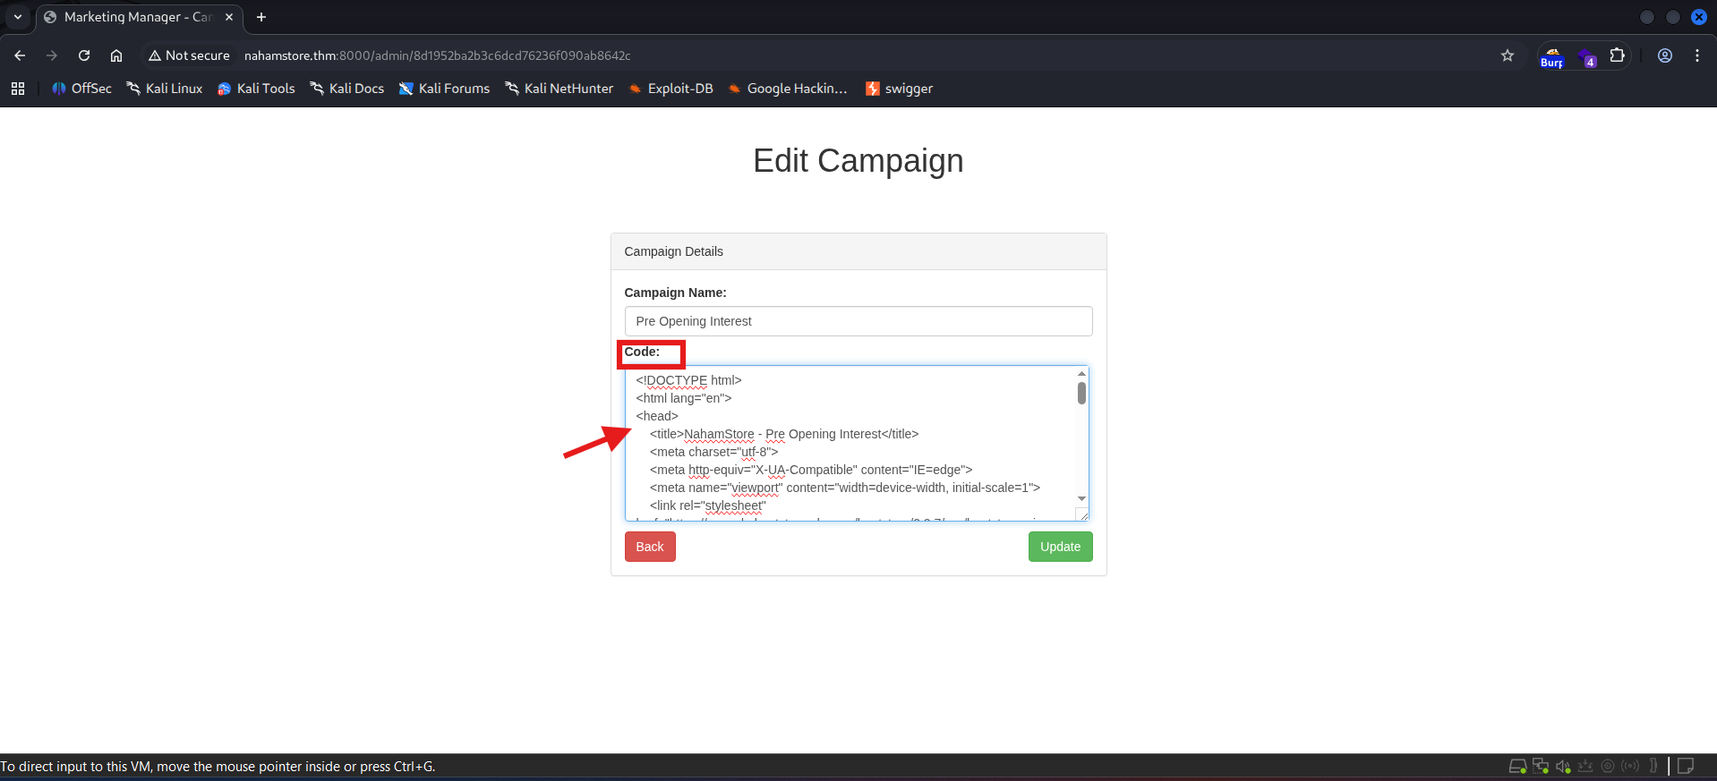
CRITICAL
Remote Code Execution via Admin Upload
CVSS v3.1 Score
9.8
CRITICAL - Immediate Remediation Required
Description
An administrative interface hosted on port 8000 allowed authenticated users to upload files which were subsequently interpreted and executed by the web server. Access to the /admin panel was obtained using default credentials (admin:admin). A PHP web shell was uploaded and executed, providing an interactive remote shell on the host.
Proof / Evidence
Logged in with default credentials (admin:admin)
Burp Suite / Browser PoC showing: Admin login with default credentials Web shell upload and execution
▸
Uploaded a PHP web shell via the admin upload feature
▸
Executed the shell and received an interactive reverse shell via netcat
▸
Impact
Full server compromise and arbitrary command execution
▸
Complete access to application files, databases, and internal resources
▸
Potential for lateral movement, data exfiltration, and persistent backdoors
▸
⚠ Additional instances of this vulnerability were found during the assessment.

Slide 7
CRITICAL
RCE Remediation & Action Plan
Immediate Actions (CRITICAL - Within 24 Hours)
Disable the admin upload feature immediately or restrict file types to non-executable formats
Remove or change the default admin:admin account credentials to a strong, unique password
Scan the server for web shells and backdoors; remove any unauthorized files
Review access logs for evidence of exploitation and unauthorized access
Implement emergency IP allowlist to restrict admin panel access to trusted networks only
Short-Term Fixes (Within 1-2 Weeks)
Implement Multi-Factor Authentication (MFA) for all administrative accounts
Move the admin panel behind a VPN or IP-restricted gateway
Configure the web server to store uploaded files outside the webroot directory
Disable PHP execution in upload directories using .htaccess or web server configuration
Implement file upload validation (whitelist allowed extensions, verify MIME types)
Conduct a full security audit of the admin panel functionality
Long-Term Security Improvements (Within 1 Month)
Implement a Web Application Firewall (WAF) to detect and block malicious file uploads
Deploy file integrity monitoring to detect unauthorized file modifications
Establish a secure file upload handler with antivirus scanning integration
Implement comprehensive logging and alerting for admin panel activities
Conduct security awareness training for administrators on secure credential management
Validation & Testing
Conduct a full re-test of the admin panel after implementing fixes
Verify that file uploads are blocked or properly restricted
Confirm that default credentials have been changed and MFA is enforced
Test that uploaded files cannot be executed from the webroot
⚠ CRITICAL ALERT
Additional instances of this vulnerability were found during the assessment. All admin upload functionality must be reviewed and secured immediately to prevent full system compromise.

Slide 8

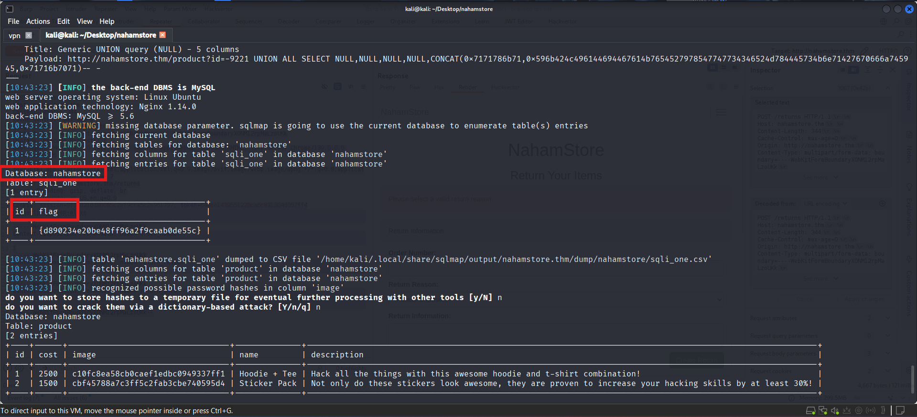
HIGH: SQL Injection in product?id
CVSS 9.1
HIGH
Description
The id parameter is vulnerable to SQL injection. User-supplied input is used unsafely in a database query, allowing injection of arbitrary SQL payloads. This enables attackers to enumerate database contents, extract sensitive data, modify or delete records, and potentially escalate privileges.
Proof / Evidence
▸
Confirmed with sqlmap automated tool
▸
Successfully enumerated database structure and contents
▸
Dumped sensitive user records and credentials
▸
See screenshot for sqlmap execution evidence
Impact
Insert Screenshot Here
Exposure of sensitive data (user records, emails, credentials, PII)
sqlmap Execution Evidence
Potential modification or deletion of database records
Privilege escalation if admin credentials are recovered
Further pivoting to internal systems and lateral movement
Recommendation
Immediate Actions: Use prepared statements/parameterized queries for all database interactions. Validate and whitelist input for the id parameter. Sanitize inputs, enforce least-privilege database accounts, and implement a Web Application Firewall (WAF) to block suspicious query patterns.
Additional instances of this vulnerability were found.

Slide 9

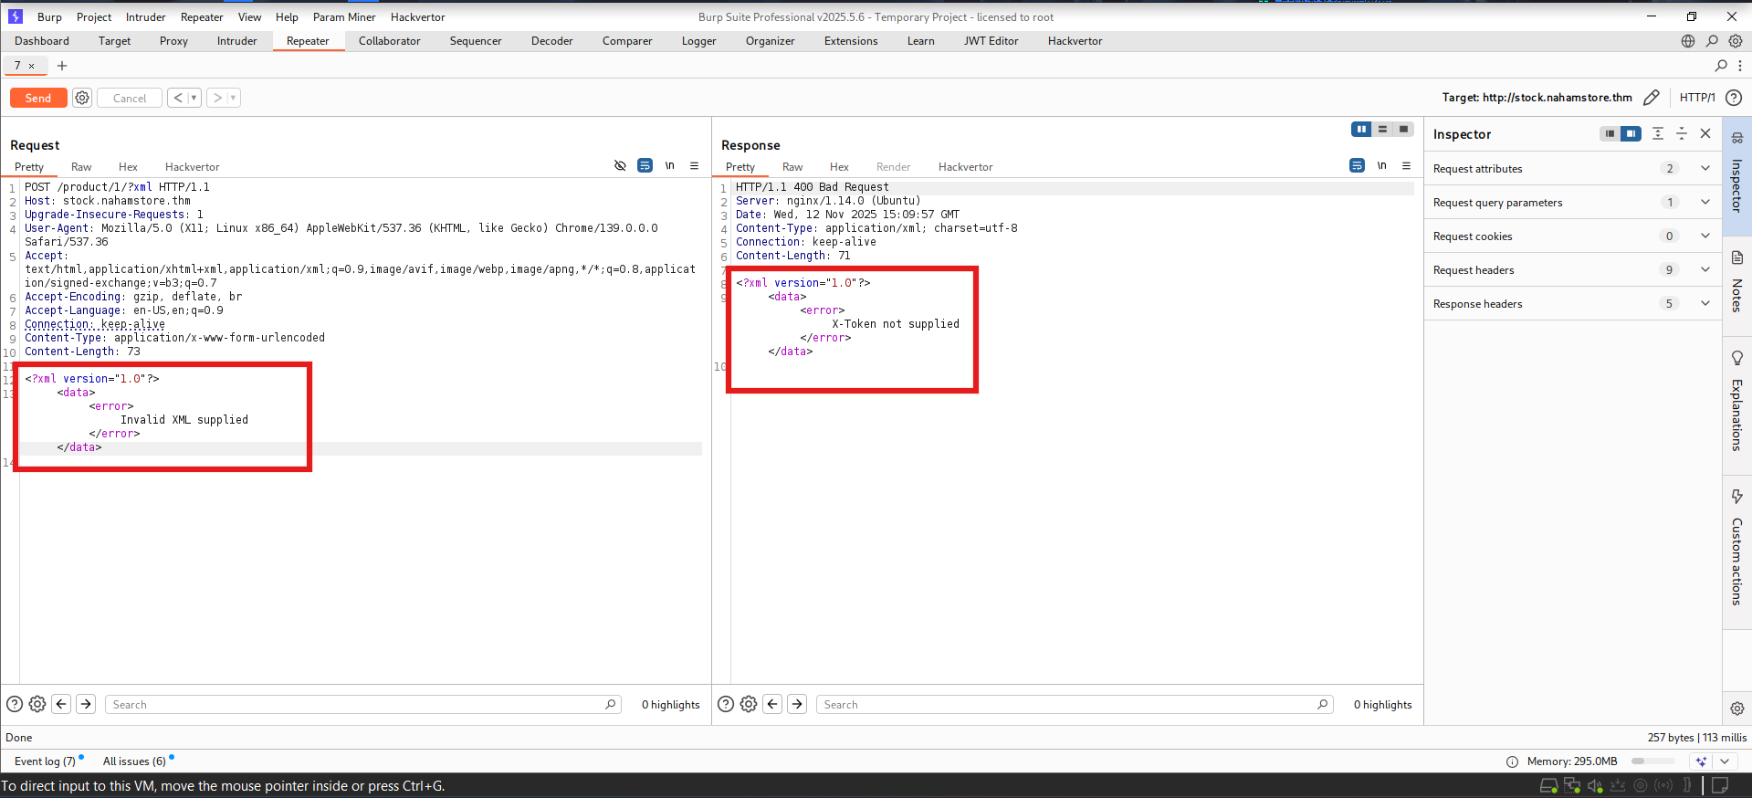
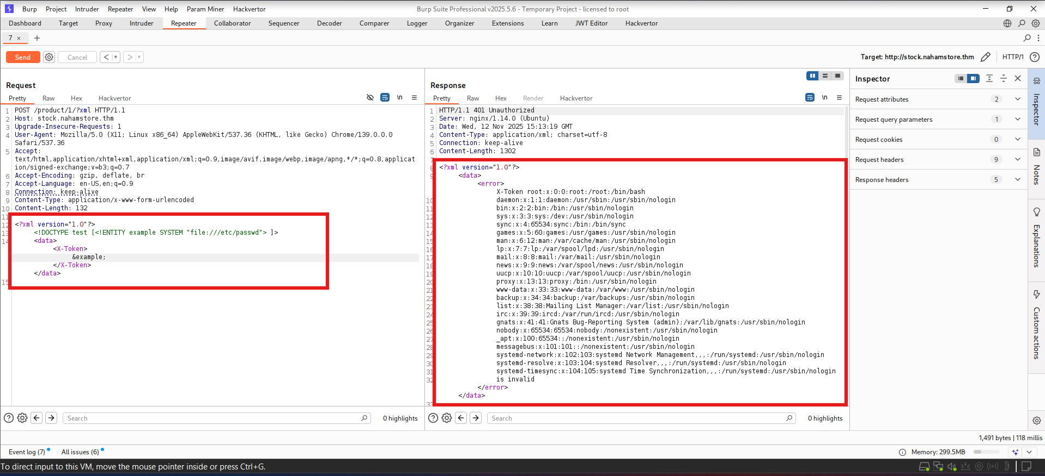
HIGH
XML External Entity (XXE) Injection
CVSS 8.6
VULNERABILITY DESCRIPTION
The XML parser accepts external entity definitions. By supplying a malicious DTD referencing local files, the application exposes server filesystem contents. An attacker can craft XML payloads to read sensitive files from the server.
PROOF OF CONCEPT
Converted the request to POST and submitted XML containing a malicious DTD referencing system files:
SYSTEM "file:///etc/passwd"
The server returned contents of /etc/passwd in the response, confirming XXE vulnerability.
Insert Screenshot Here
IMPACT
XXE Vulnerability Evidence
• Disclosure of sensitive local files (configs, credentials) • Access to /etc/passwd and other system files • Potential escalation to SSRF or RCE • Information disclosure for further attacks
RECOMMENDATION
Disable external entity resolution in the XML parser. Validate and whitelist XML inputs. Use safer parsing libraries or configure the parser to prohibit external DTDs and access to local files.
Additional instances of this vulnerability were found

Slide 10

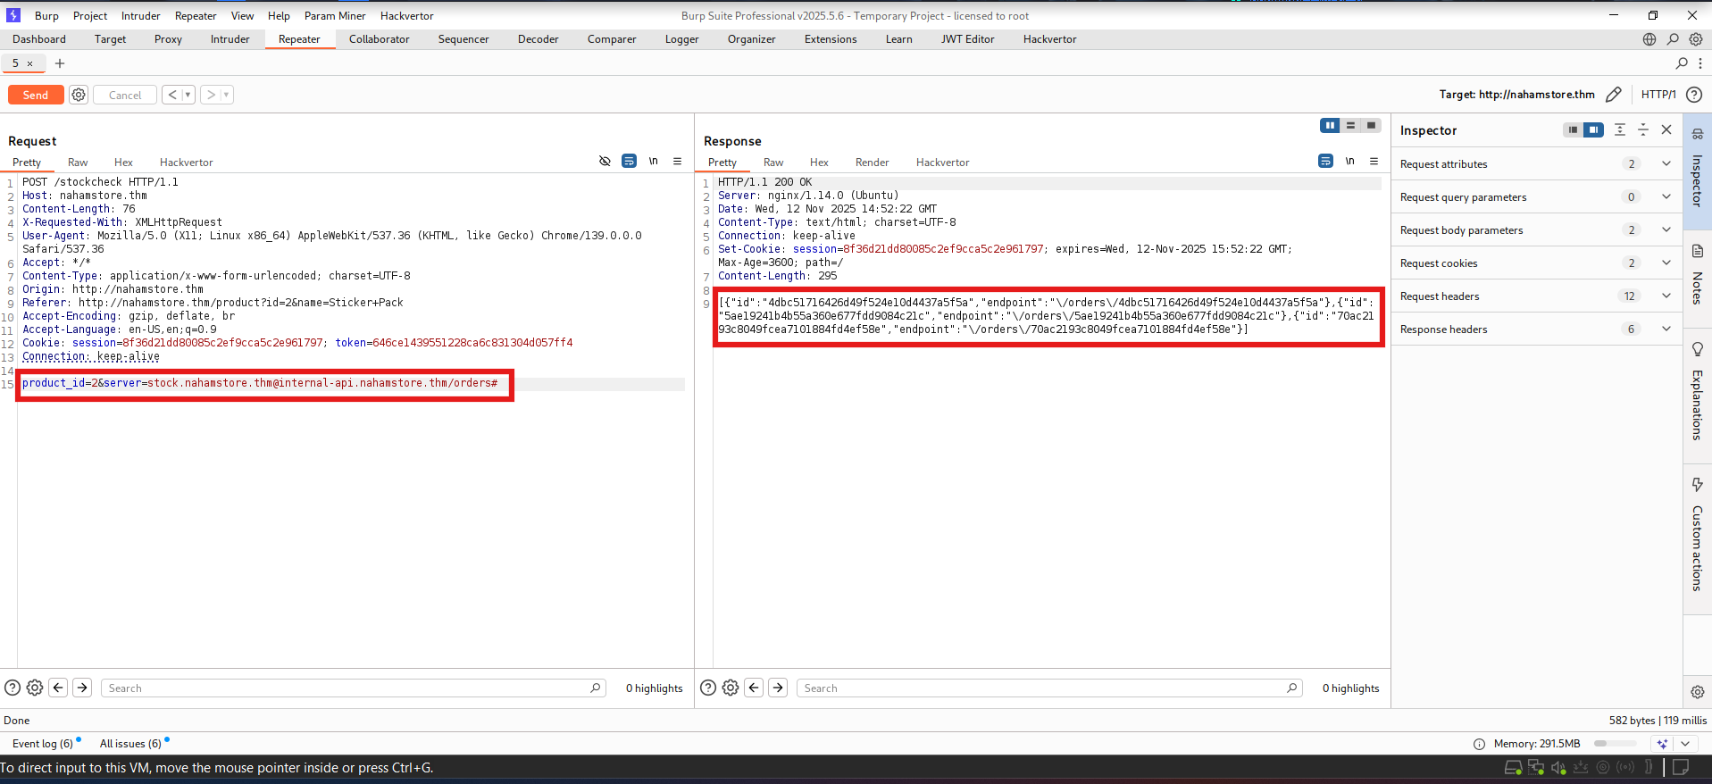
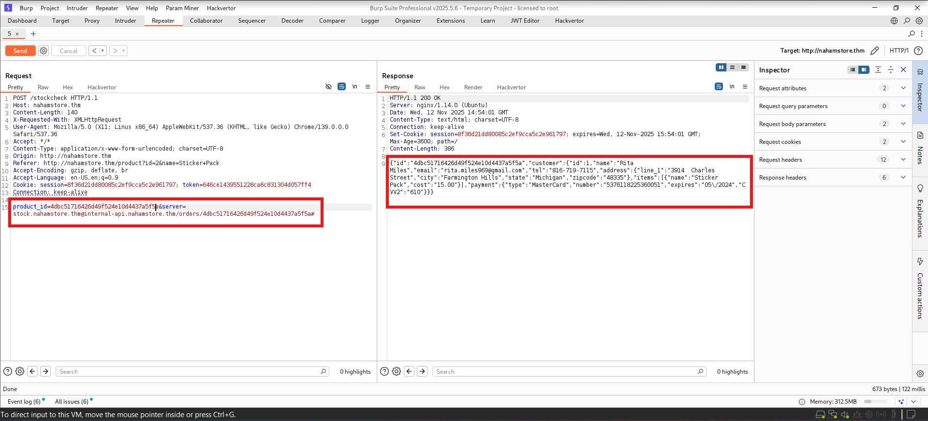
HIGH
Server-Side Request Forgery (SSRF)
CVSS 8.6
VULNERABILITY DESCRIPTION
The server parameter is used to initiate backend requests without proper validation. By abusing the parameter format, an attacker can manipulate the application to make requests to internal services. The application made requests to internal service internal-api.nahamstore.thm and allowed access to internal endpoints.
PROOF OF CONCEPT
Using the following payload in the server parameter in POST request:
server=stock.nahamstore.thm@internal-api.nahamstore.thm/orders#
The application successfully accessed the internal orders endpoint, exposing sensitive customer data.
🔗
IMPACT
Insert Screenshot Here
▸
SSRF Payload Execution Evidence
Access to internal-only services and endpoints
▸
Disclosure of sensitive data (customer orders, internal files)
▸
Potential lateral access to internal systems
▸
Metadata service exploitation (cloud environments)
▸
Bypass of network segmentation controls
RECOMMENDATION
Validate and whitelist allowable hostnames/URLs server-side. Disallow user-controlled requests to internal or private IP ranges (10.0.0.0/8, 172.16.0.0/12, 192.168.0.0/16). Implement strict URL parsing/validation, enforce egress network controls, and require authenticated, internal-only channels for service-to-service requests.
Additional instances of this vulnerability were found

Slide 11

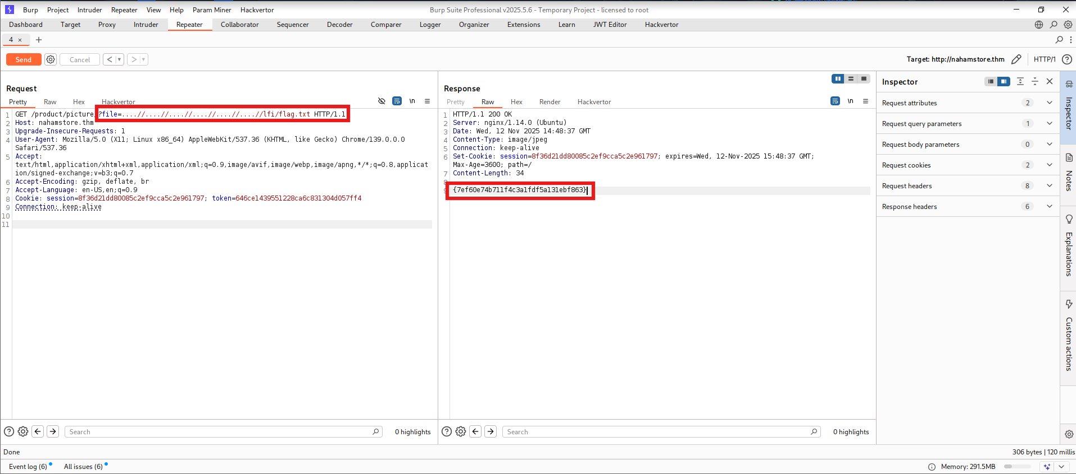
HIGH
Local File Inclusion (LFI) via Directory Traversal
CVSS 8.0
VULNERABILITY DESCRIPTION
The file parameter is susceptible to directory traversal attacks. User-supplied input is not properly validated or canonicalized, allowing attackers to use path traversal sequences to read arbitrary files from the server filesystem, including sensitive configuration files, credentials, and internal data.
PROOF OF CONCEPT
Example directory traversal payload successfully read sensitive files:
.... // .... // .... // .... // .... // .... //lfi/flag.txt
📁
The application returned the contents of the target file, confirming the LFI vulnerability.
IMPACT
Insert Screenshot Here
Disclosure of sensitive local files (configs, secrets, flags)
LFI Exploitation Evidence
Access to application source code and configuration
Exposure of database credentials and API keys
Potential escalation to RCE via log poisoning or writable uploads
RECOMMENDATION
Canonicalize and validate file paths server-side. Serve files by ID mapped to allowed paths and block traversal sequences. Run the application with least privilege so sensitive files are inaccessible to the web server process.
Additional instances of this vulnerability were found

Slide 12

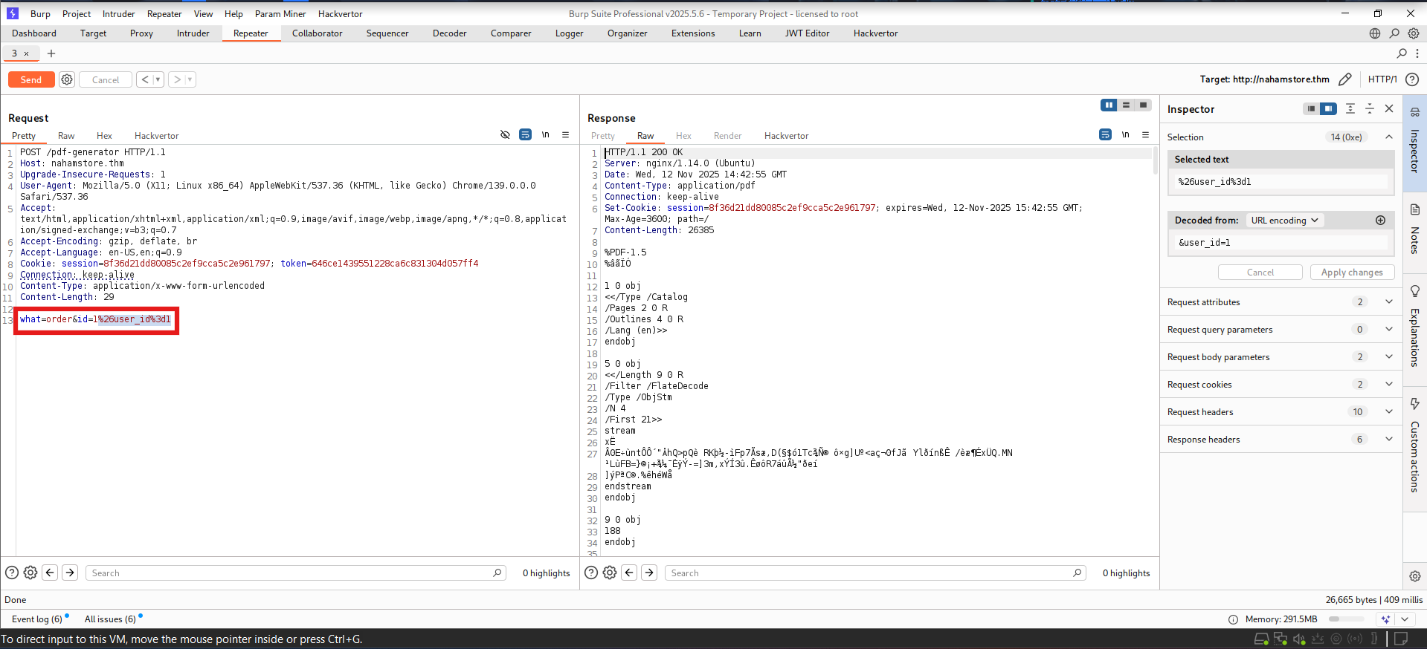
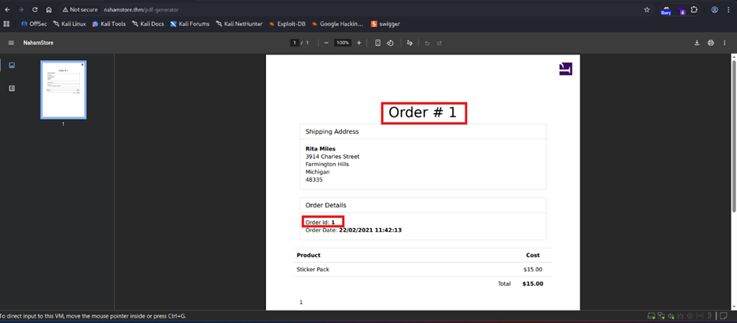
MEDIUM
Insecure Direct Object Reference (IDOR)
CVSS 6.5
VULNERABILITY DESCRIPTION
The pdf-generate endpoint accepts a user_id parameter that is not properly authorized. The application fails to verify that the requesting user is permitted to access the requested user_id. By changing the user_id value in a POST request, an attacker can retrieve PDF reports belonging to other users without proper authorization checks.
PROOF OF CONCEPT
Changed the HTTP method to POST and included another user's user_id parameter in the request:
POST /pdf-generate HTTP/1.1 user_id=12345
🔐
The response returned that user's sensitive report without any authorization verification.
IMPACT
Insert Screenshot Here
• Disclosure of other users' sensitive reports and PII • Access to order history, personal data, and confidential information • Privacy breaches and compliance violations (GDPR, etc.) • Potential for targeted attacks using disclosed information
IDOR Authorization Bypass Evidence
RECOMMENDATION
Enforce server-side authorization checks to verify the requesting user is permitted to access the requested user_id. Avoid using user-controllable identifiers directly; map public tokens/IDs to internal resources server-side. Implement logging and alerts for abnormal access patterns.
Additional similar cases exist

Slide 13

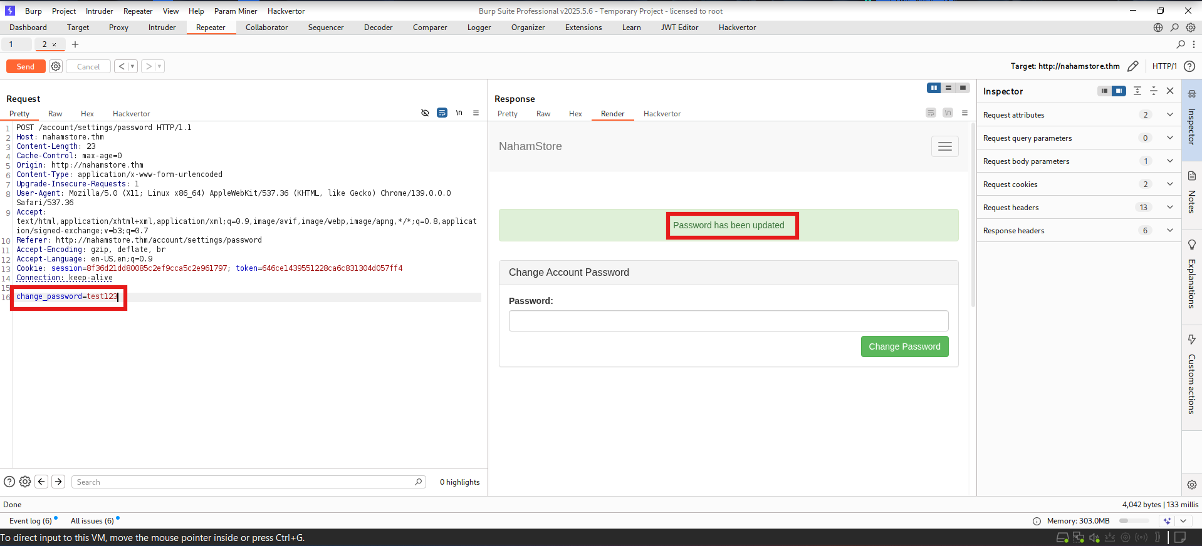
MEDIUM
CSRF #1 - Change Password Vulnerability
CVSS 6.1
VULNERABILITY DESCRIPTION
The change-password endpoint lacks proper CSRF (Cross-Site Request Forgery) protections. The application does not validate anti-CSRF tokens or verify the request origin. An attacker can craft a malicious webpage that, when visited by a logged-in user, forces a password change without the user's knowledge or consent.
PROOF OF CONCEPT
A simple HTML form (POST) submitted to the change-password endpoint successfully changed the target account's password when executed in an authenticated browser context. No CSRF token was required or validated.
<form action="https://nahamstore.thm/change-password" method="POST"> <input name="new_password" value="attacker_password"> <input type="submit"> </form>
🔑
Insert Screenshot Here
IMPACT
CSRF Password Change Evidence
• Attacker can force password changes for logged-in users • Complete account takeover and loss of user access • Unauthorized access to sensitive user data and functionality • Potential for privilege escalation if admin accounts are targeted
RECOMMENDATION
Enforce anti-CSRF tokens for all state-changing requests. Validate the Origin and Referer headers. Require re-authentication for sensitive actions like password changes. Implement SameSite cookie attributes to prevent cross-site cookie transmission.
Additional similar cases exist

Slide 14

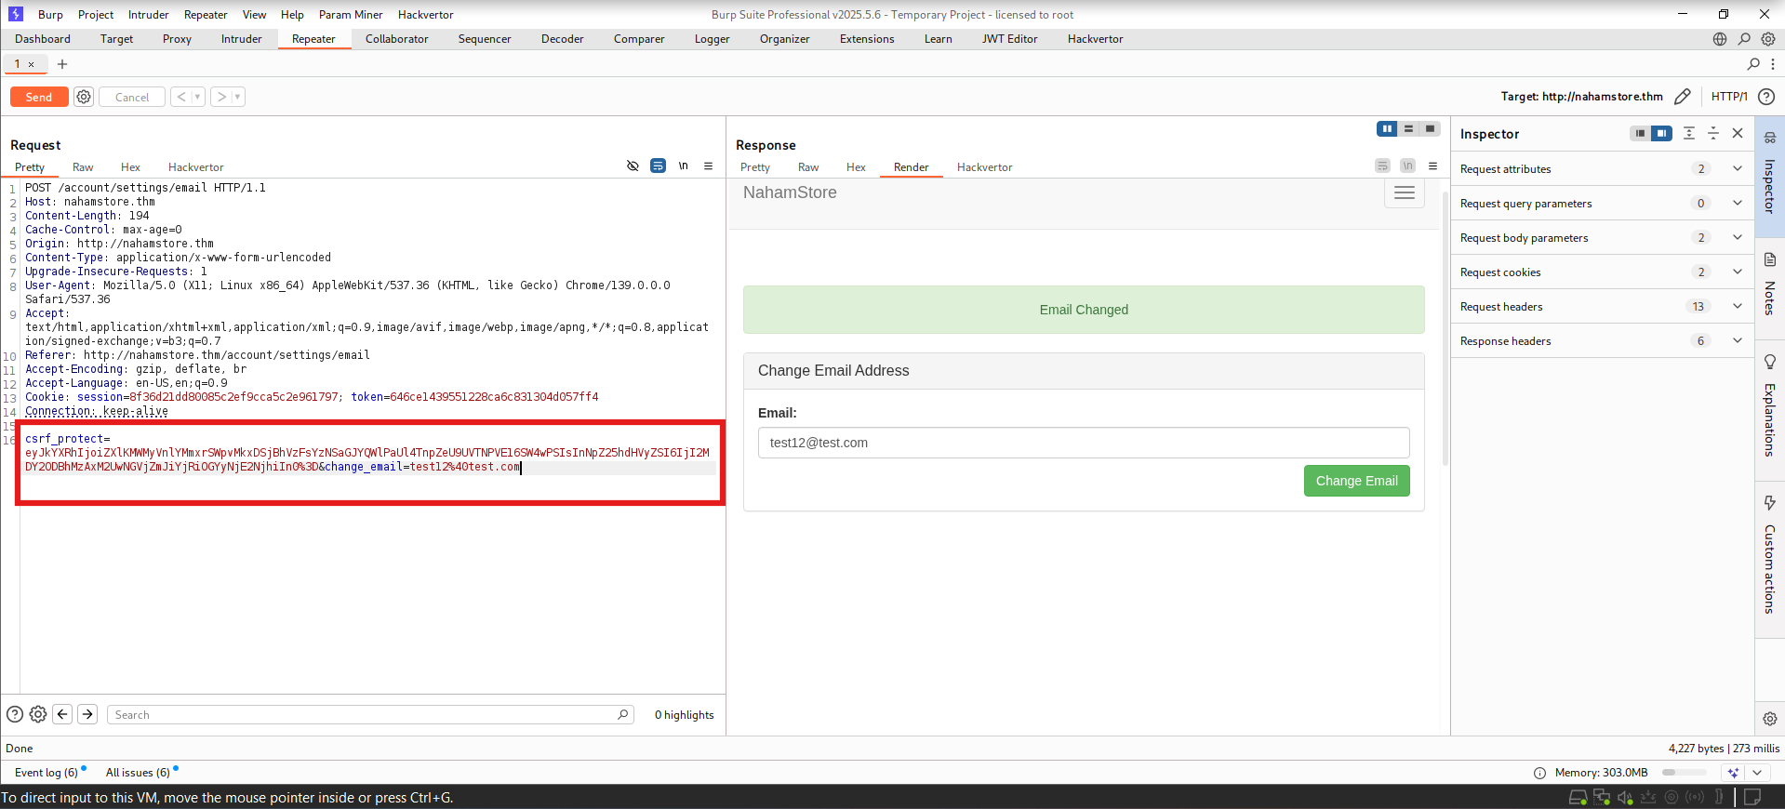
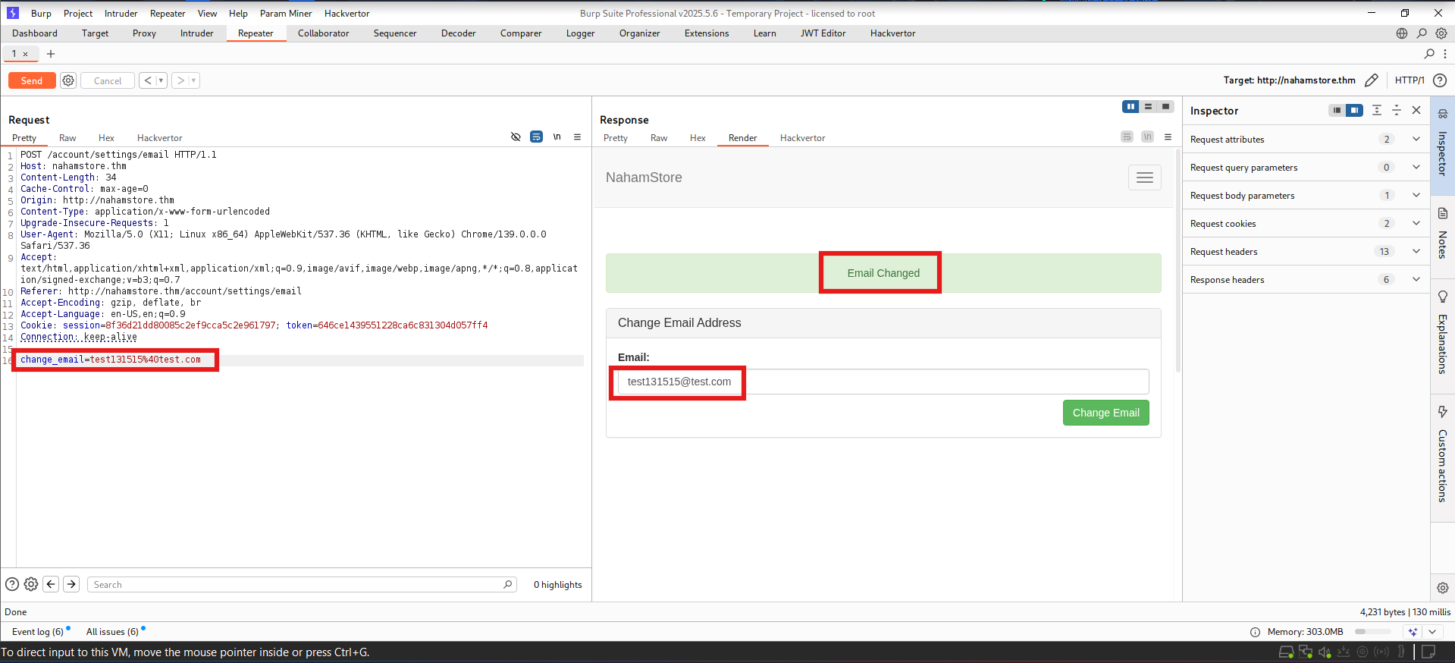
MEDIUM
CSRF #2 - Broken Email Change Protection
CVSS 6.1
VULNERABILITY DESCRIPTION
The change-email endpoint implements a flawed CSRF protection mechanism. While a CSRF token is generated, the validation logic is broken: removing the token parameter from the request still allows the email change to succeed. This indicates the CSRF token validation is not properly enforced, allowing attackers to bypass the protection entirely.
PROOF OF CONCEPT
A POST request to the change-email endpoint without the CSRF token parameter successfully changed the user's email address. The application accepted the request despite the missing token.
POST /change-email HTTP/1.1 new_email=attacker@evil.com (no csrf_token parameter)
IMPACT
Insert Screenshot Here
• Attacker can force email changes for logged-in users • Account takeover via password reset to attacker's email • Loss of user access and control over their account • Potential for credential recovery and privilege escalation
CSRF Email Change Evidence
RECOMMENDATION
Implement proper CSRF token validation that rejects requests without valid tokens. Ensure the token is required and correctly validated before processing email changes. Require re-authentication for sensitive account changes. Implement SameSite cookie attributes and validate Origin/Referer headers as additional protections.
Additional similar cases exist

Slide 15

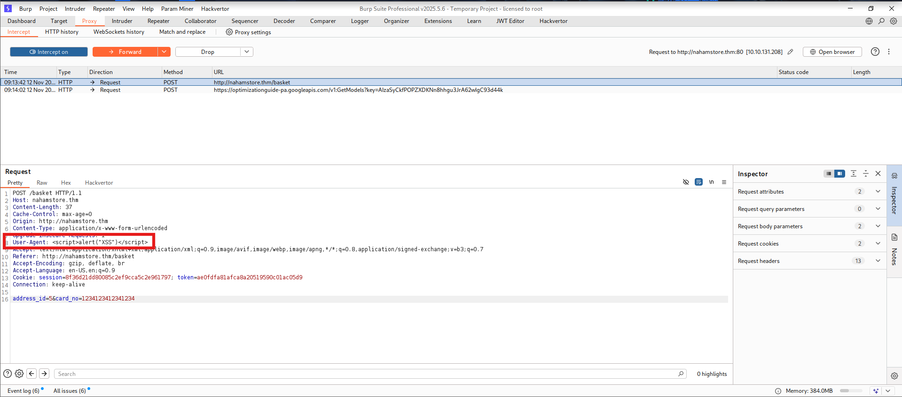
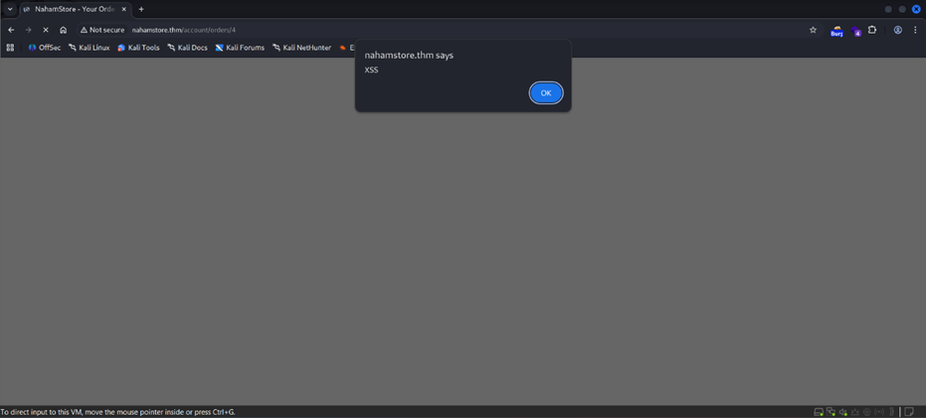
MEDIUM
Stored XSS via User-Agent Header
CVSS 6.1
VULNERABILITY DESCRIPTION
The application stores the HTTP User-Agent header from incoming requests and displays it on the /basket page without proper sanitization or encoding. An attacker can inject malicious JavaScript code through the User-Agent header, which will be stored in the application and executed in the browsers of all users who visit the /basket page, enabling persistent XSS attacks.
PROOF OF CONCEPT
A request with a malicious User-Agent header containing JavaScript was sent to the application:
User-Agent: <img src=x onerror="alert('XSS')">
The payload was stored and executed on the /basket page for all users, confirming the stored XSS vulnerability.
Insert Screenshot Here
IMPACT
Stored XSS Execution on /basket Page
• Persistent JavaScript execution in all user browsers • Session hijacking and cookie theft • Malware distribution and credential harvesting • Defacement and phishing attacks targeting all users • Widespread compromise affecting all application users
RECOMMENDATION
HTML-encode all user-supplied input before rendering, including HTTP headers. Implement a Content Security Policy (CSP) to restrict script execution. Validate and sanitize all input server-side. Use templating engines that auto-escape output by default.
Additional similar cases exist

Slide 16

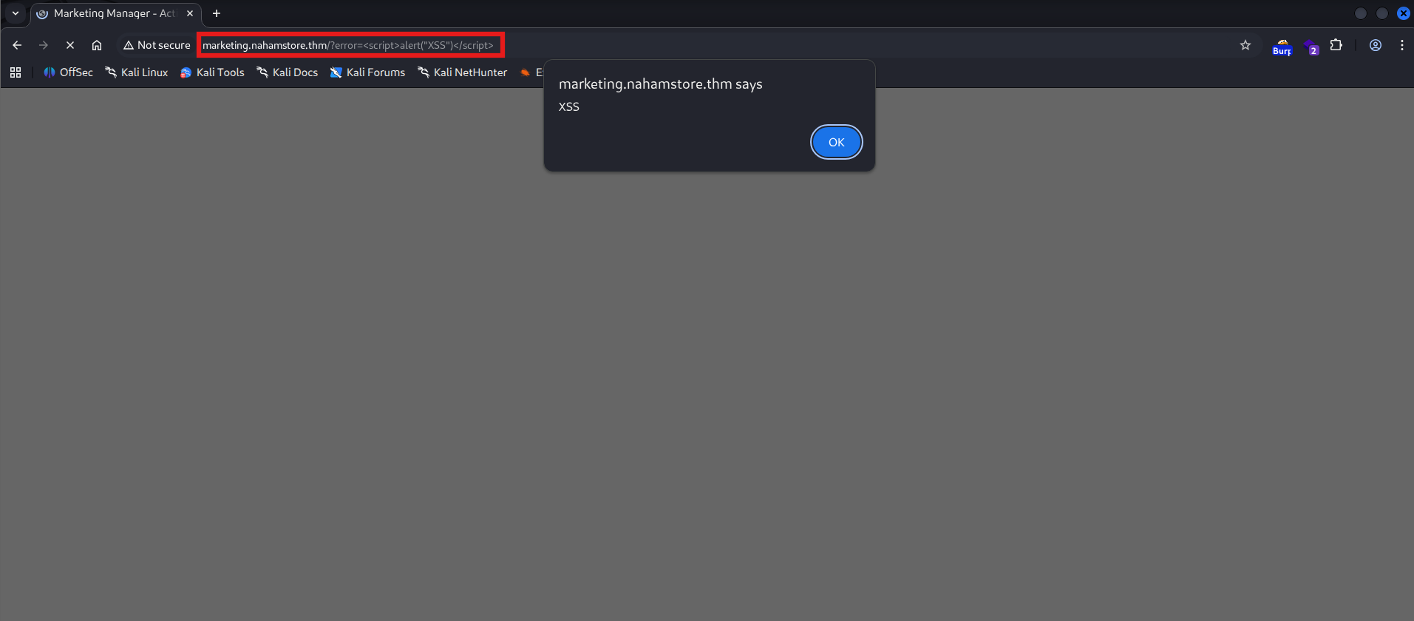
LOW
Reflected Cross-Site Scripting (6 Cases)
CVSS 4.3
VULNERABILITY DESCRIPTION
Reflected XSS vulnerabilities were found in six different parameters across the application. User-supplied input is reflected in the HTTP response without proper encoding or sanitization. An attacker can craft a malicious URL containing JavaScript code that executes in the victim's browser when the link is visited.
VULNERABLE PARAMETERS (6 TOTAL)
error
q
id
auth
textarea
path
⚡
PROOF OF CONCEPT (error parameter)
Example URL with XSS payload in the error parameter:
Insert Screenshot Here
https://nahamstore.thm/?error=<script>alert('XSS')</script>
Reflected XSS Payload Execution Evidence
The JavaScript payload executes in the victim's browser when the link is visited.
See next slide for impact analysis and recommendations

Slide 17

LOW
Reflected XSS (Continued) - Remediation & Prevention
Detailed Impact Analysis
Session Hijacking:
Attacker steals session cookies to impersonate users and gain unauthorized access to accounts
Phishing Attacks:
Malicious scripts inject fake login forms or redirect users to attacker-controlled phishing sites
Malware Distribution:
Injected scripts download and execute malware, leading to system compromise
Credential Harvesting:
Fake forms capture user credentials (usernames, passwords, payment information)
Defacement:
Attacker modifies page content to display malicious messages or propaganda
User Impersonation:
Attacker performs actions on behalf of the victim user within the application
Comprehensive Remediation Strategy
Output Encoding:
HTML-encode all user-supplied input before rendering (error, q, id, auth, textarea, path parameters)
Content Security Policy (CSP):
Implement strict CSP headers to restrict inline script execution and external script sources
Input Validation:
Validate all user inputs on the server-side to reject malicious payloads before processing
Security Libraries:
Use DOMPurify or similar libraries for client-side sanitization of dynamic content
Template Engines:
Use templating engines with auto-escape features to prevent injection vulnerabilities
Security Headers:
Implement X-XSS-Protection and X-Content-Type-Options headers for additional protection
All Vulnerable Parameters (6 Total)
error
q
id
auth
textarea
path
All six parameters require immediate remediation using the same output encoding and validation strategies. Each parameter should be treated as untrusted input and properly encoded before rendering in the HTTP response.
Best Practices for Prevention
✓ Always encode output based on context (HTML, JavaScript, URL, CSS)
✓ Implement a Web Application Firewall (WAF) to detect XSS patterns
✓ Use security headers (CSP, X-XSS-Protection, X-Content-Type-Options)
✓ Conduct regular security testing and code reviews for XSS vulnerabilities
✓ Train developers on secure coding practices and XSS prevention
✓ Monitor and log suspicious user activity and injection attempts

Slide 18

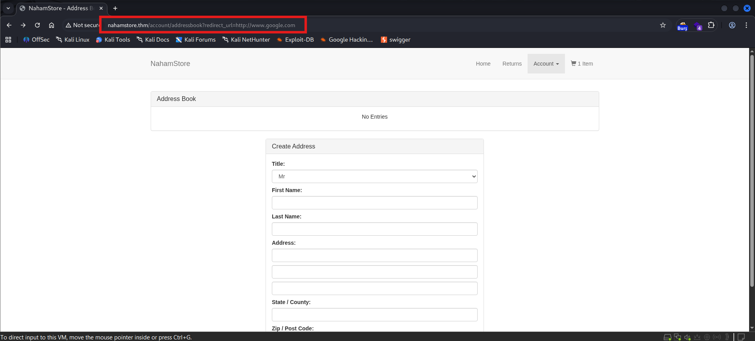
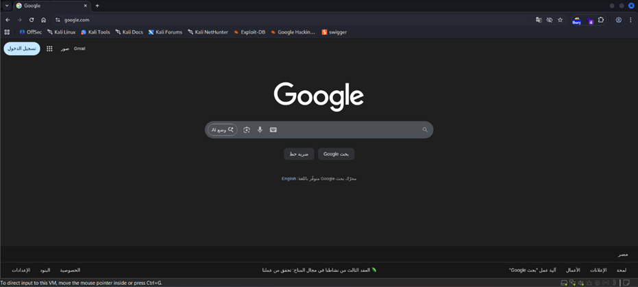
LOW
Open Redirects (4 Cases)
CVSS 3.4
VULNERABILITY DESCRIPTION
The application contains multiple unvalidated redirect parameters that allow attackers to redirect users to arbitrary external URLs. These open redirects are commonly found in login/logout flows and post-action redirects. An attacker can craft a legitimate-looking link that redirects to a malicious phishing site after the user completes an action.
PROOF OF CONCEPT - EXAMPLE 1
The redirect parameter in the login endpoint accepts arbitrary URLs without validation:
/login?redirect=https://attacker.com/phishing
After successful authentication, the user is redirected to the attacker's phishing site instead of the legitimate application.
IMPACT
Insert Screenshot Here
• Phishing attacks using legitimate domain in initial URL • Credential harvesting through fake login pages • Malware distribution and drive-by downloads • Social engineering and user trust exploitation • Bypass of email security filters (legitimate domain in link)
Open Redirect Exploitation Evidence
RECOMMENDATION
Whitelist allowed redirect destinations server-side. Validate redirect URLs against a list of safe internal URLs. Avoid using user-supplied redirect parameters; instead, use numeric IDs mapped to safe URLs. Implement URL validation to ensure redirects stay within the application domain.
4 similar cases found in the application

Slide 19
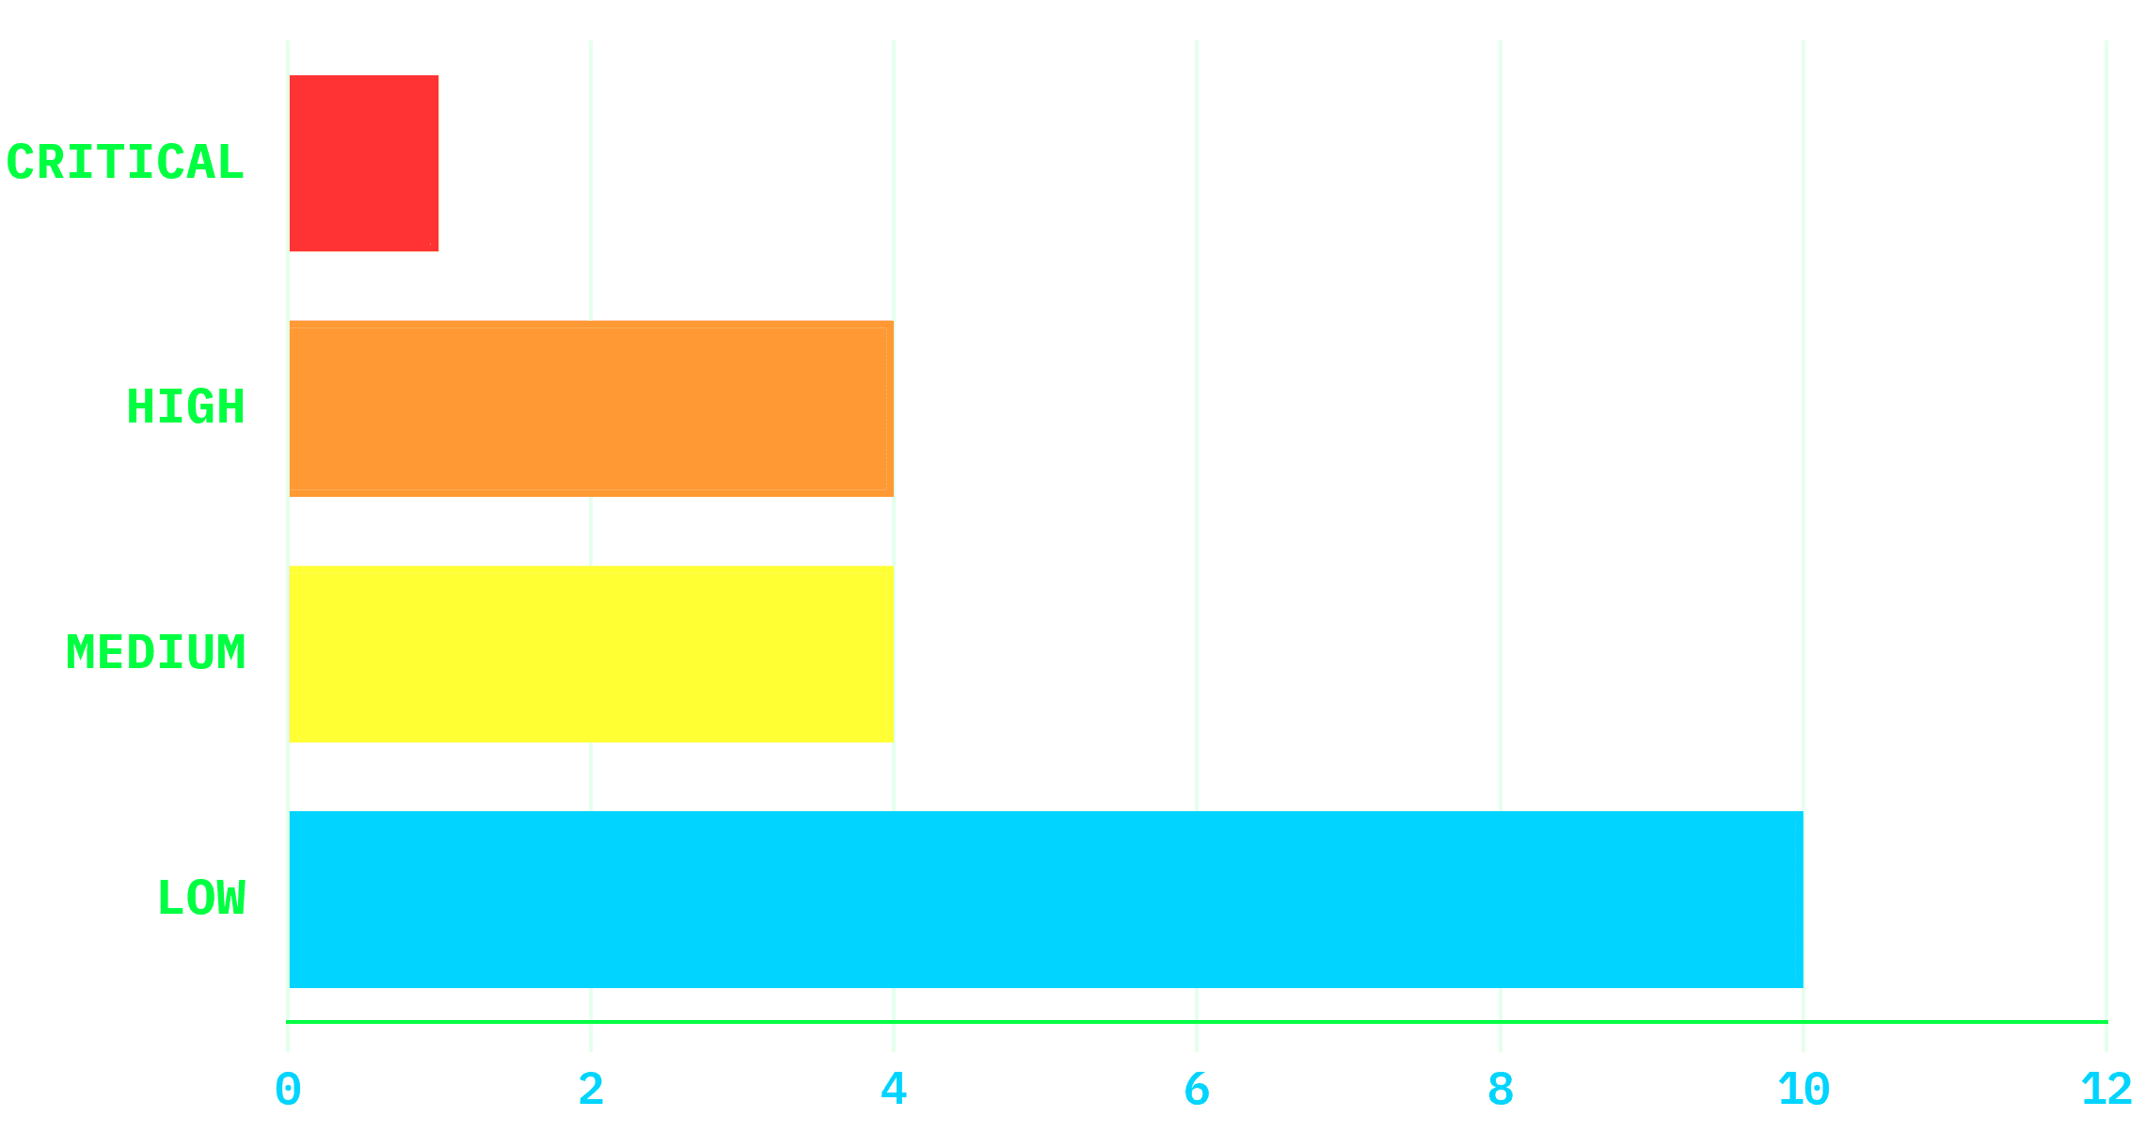
Risk Summary and Severity Distribution
1
CRITICAL
5% of findings
4
HIGH
21% of findings
4
MEDIUM
21% of findings
10
LOW
53% of findings
Total Findings
19 vulnerabilities identified across the Nahamstore application. Immediate remediation of critical and high-severity findings is required to reduce risk exposure.

Slide 20

Consolidated Findings Reference Table
Severity
Vulnerability
CVSS
Description
CRITICAL
Remote Code Execution (RCE)
9.8
Default credentials (admin:admin) on admin panel port 8000 allow file upload and execution of arbitrary code via web shell
HIGH
SQL Injection (product?id)
9.1
Unsanitized id parameter allows SQL injection; confirmed with sqlmap to enumerate database and extract sensitive data
HIGH
XML External Entity (XXE)
8.8
XXE injection in XML parsing allows file disclosure and SSRF attacks; tested with local file inclusion payloads
HIGH
Server-Side Request Forgery (SSRF)
8.6
Server parameter allows requests to internal services (internal-api.nahamstore.thm); exposes internal orders endpoint
HIGH
Local File Inclusion (LFI)
8.0
Directory traversal via file parameter allows reading arbitrary files; confirmed with path traversal sequences
MEDIUM
Insecure Direct Object Reference (IDOR)
6.5
pdf-generate endpoint lacks authorization checks; user_id parameter allows access to other users' reports
MEDIUM
CSRF #1 - Change Password
6.1
change-password endpoint lacks CSRF token validation; allows forced password changes on authenticated users
MEDIUM
CSRF #2 - Change Email
6.1
change-email endpoint has broken CSRF protection; token removal still allows email changes without validation
MEDIUM
Stored XSS - User-Agent
6.1
User-Agent header stored and rendered on /basket page without sanitization; enables persistent script execution
LOW
Reflected XSS (6 cases)
4.3
Reflected XSS found in 6 parameters: error, q, id, auth, textarea, path; enables phishing and session theft
LOW
Open Redirects (4 cases)
3.4
Unvalidated redirect parameters in 4 locations allow redirection to arbitrary external URLs; enables phishing attacks

Slide 21
Remediation Roadmap & Priority Actions
Organized by Severity Level & Timeline
CRITICAL
Immediate Actions Required
24-48 Hours
RCE:
Disable admin upload feature; change default credentials (admin:admin); scan for web shells; review access logs
SQL Injection:
Implement parameterized queries; validate id parameter; deploy WAF rules to block SQL patterns
XXE:
Disable XML external entity processing; use safe XML parsers; validate XML input
SSRF:
Whitelist allowed hostnames; block requests to private IP ranges (10.0.0.0/8, 172.16.0.0/12, 192.168.0.0/16)
LFI:
Canonicalize file paths; block directory traversal sequences; implement access controls
MEDIUM
Short-Term Fixes
1-2 Weeks
CSRF:
Implement anti-CSRF tokens for all state-changing requests; validate Origin/Referer headers; enforce SameSite cookies
IDOR:
Enforce server-side authorization checks; map public IDs to internal resources; implement access logging
Stored XSS:
HTML-encode all output; implement Content Security Policy (CSP); sanitize user inputs server-side
Input Validation:
Validate all user inputs on the server-side; use security libraries for sanitization
LOW
Long-Term Improvements
1 Month
Reflected XSS (6 cases):
Implement context-aware output encoding; deploy CSP; use security libraries for sanitization
Open Redirects (4 cases):
Whitelist allowed redirect destinations; validate URLs against safe internal URLs only
Security Hardening:
Implement Web Application Firewall (WAF); deploy file integrity monitoring; enable comprehensive logging
Security Training:
Conduct developer security awareness training; implement secure coding practices; establish code review process
General Security Practices (All Priorities)
Implement comprehensive logging and monitoring
✓
Deploy a Web Application Firewall (WAF)
✓
Conduct regular security assessments
✓
Enforce least-privilege access controls
✓
Implement Multi-Factor Authentication (MFA)
✓
Establish incident response procedures
✓

Slide 22

Conclusion and Next Steps
Executive Summary
This penetration test identified 19 vulnerabilities across the Nahamstore web application. The critical RCE vulnerability poses an immediate threat to the entire application and infrastructure. Immediate remediation of Critical and High-severity findings is essential to reduce risk exposure.
1
4
4
10
CRITICAL
HIGH
MEDIUM
LOW
Immediate Actions (24-48 Hours)
Disable or restrict the admin upload feature on port 8000
Change default admin credentials (admin:admin) to strong, unique passwords
Scan the server for web shells and backdoors; remove any unauthorized files
Review access logs for evidence of exploitation and unauthorized access
Implement emergency IP allowlist to restrict admin panel access to trusted networks only
↓ Continue to next slide for short-term actions, long-term improvements, and monitoring strategies ↓

Slide 23
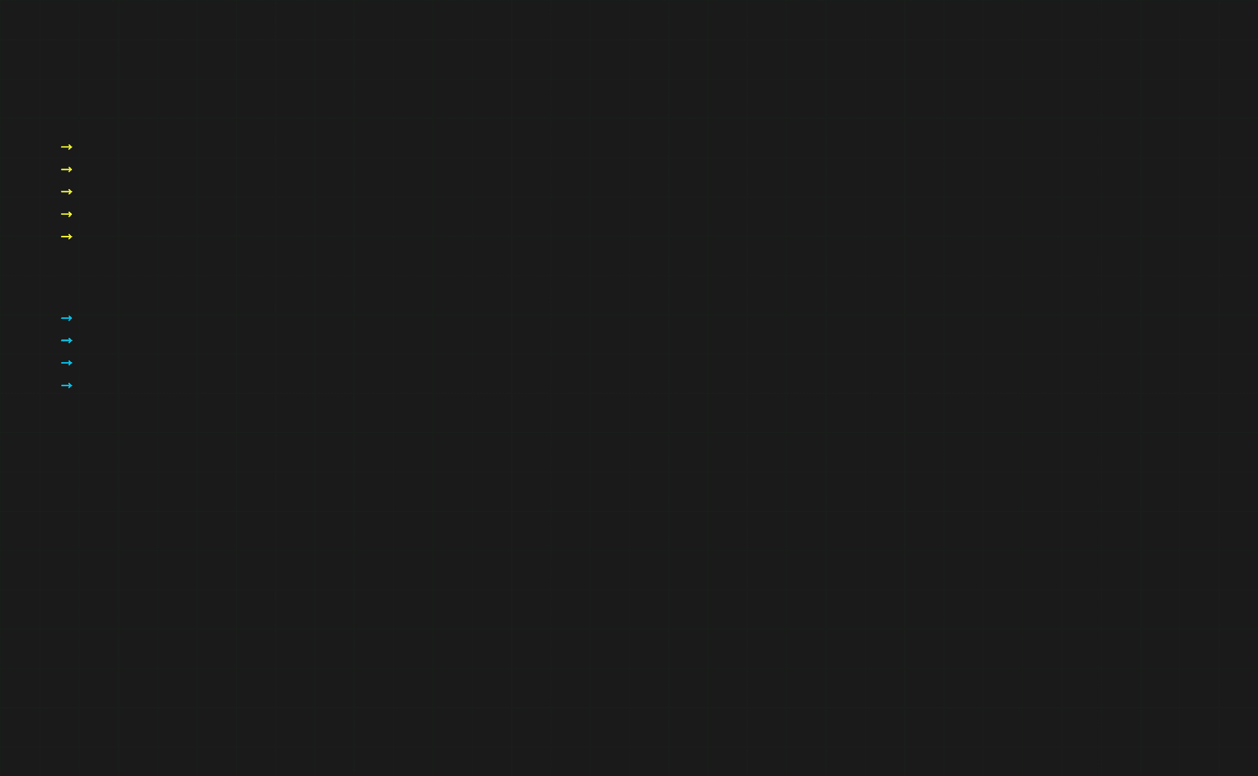
Conclusion and Next Steps (Continued)
Short-Term Actions (1-2 Weeks)
Implement parameterized queries and input validation for SQL injection prevention
Deploy anti-CSRF tokens and enforce authorization checks for all state-changing requests
Implement output encoding and Content Security Policy (CSP) for XSS prevention
Implement Multi-Factor Authentication (MFA) for all administrative accounts
Deploy a Web Application Firewall (WAF) to detect and block malicious requests
Long-Term Improvements (1 Month+)
Establish a secure software development lifecycle (SSDLC) with security code reviews
Implement comprehensive logging, monitoring, and alerting for security events
Conduct regular security awareness training for development and operations teams
Schedule periodic penetration tests and vulnerability assessments (quarterly/semi-annually)
Continuous Security Monitoring
• Real-time intrusion detection and prevention
• Web application firewall (WAF) rules and tuning
• Vulnerability scanning and patch management
• Security event logging and analysis
• Access control and authentication monitoring
• Incident response and threat hunting
Re-Testing Timeline
After implementing critical and high-priority fixes, conduct a follow-up penetration test within 2-4 weeks to validate remediation effectiveness. Schedule quarterly assessments to ensure ongoing security posture.
CRITICAL PRIORITY: The identified vulnerabilities require immediate attention and remediation. The presence of a critical RCE vulnerability combined with weak authentication poses an extreme risk to the application and organization. We recommend prioritizing the immediate actions outlined above and establishing a comprehensive security improvement program to address medium and long-term security enhancements.

Slide 24

Questions & Answers
Let's Discuss Your Security Findings
Key Takeaways
🔴
📊
Critical Findings
Total Vulnerabilities
1 Critical RCE vulnerability requires immediate remediation within 24-48 hours to prevent system compromise.
19 vulnerabilities identified across severity levels: 1 Critical, 4 High, 4 Medium, 10 Low.
🛡️
🔄
Remediation Roadmap
Continuous Monitoring
Comprehensive action plan provided with immediate (24-48h), short-term (1-2w), and long-term (1m+) fixes.
Ongoing security monitoring and periodic re-testing recommended to maintain security posture.

Slide 25

Thank You

